Slide 1
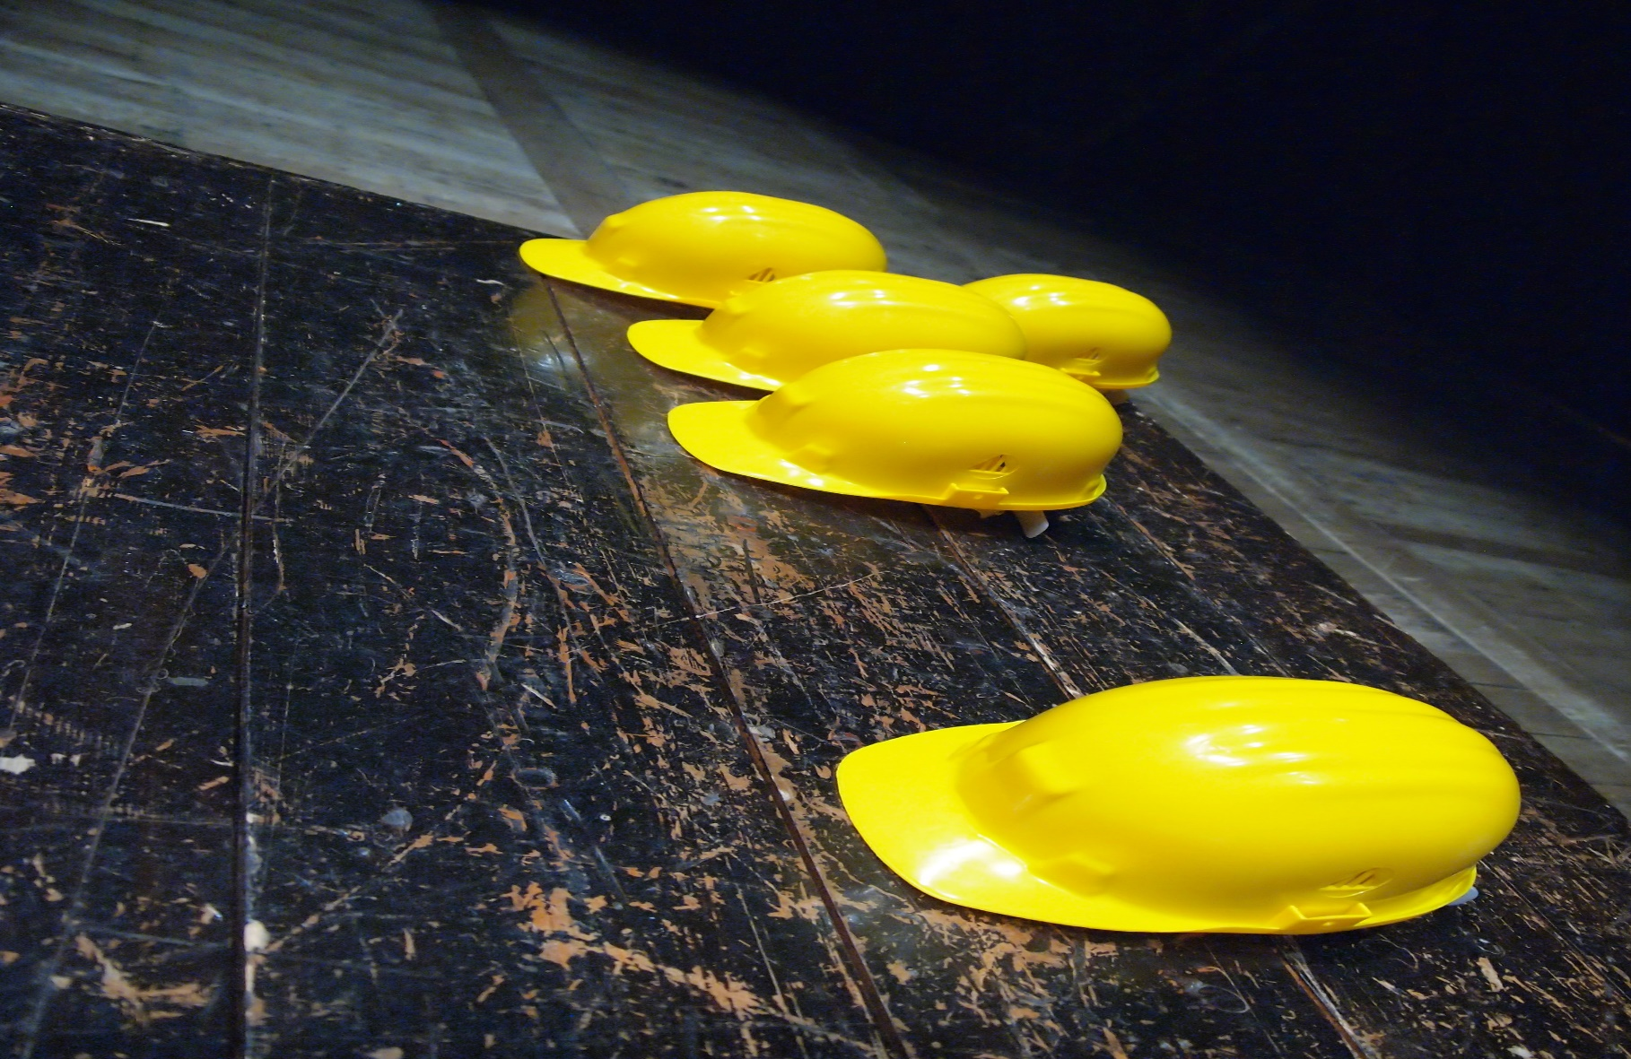

COMPANY
PROFILE
KAMOTHABO K
TRADING ENTERPRISE

Slide 2
We take pride in everything that we do and act with honesty and integrity.

Slide 3
CONTENTS
ABOUT US | 01
COMPANY DETAILS | 02
MISSION & VISSION | 03
CONSULTING SERVICES | 04
COMPANY ORGANOGRAM | 05
OUR SERVICES | 06

Slide 4

01
KAMOTHABO K TRADING ENTERPRISE
ABOUT US
KAMOTHABO K TRADING ENTERPRISE (PTY) LTD is a company from Moruleng village. The founder of the the comapany is a dynamic orientated black who is able to grow the company globally. The directors of the comapny are goal driven and are passionate .
The aim is to assist to fight youth employment & be able to assist the youth by providing, skills & empowering them to reach their goals. Our ambition is to see the company growing and been listed in the JSE. The founder has numerous skills and is a very hard working individual, who loves to empower other people & his keen to help those who are in need.
We take pride in everything that we do and act with honesty and integrity.

Slide 5

02
KAMOTHABO K TRADING ENTERPRISE
COMPANY DETAILS
Business Address
North West
Moruleng Matlotleng Section
House no 617
Director Name : Macdonald Thapelo Kgalegi
Cell No : 079 016 7155/ 069 423 0615
Email Address : thapelokgalegi23@gmail.com
Company Reg : 2023 / 655764 / 07
Tax reference : 9786714189
“Goal driven”

Slide 6
03
KAMOTHABO K TRADING ENTERPRISE
MISSION & VISION
MISSION
VISION
To ensure our clients are satisfied with our work
To ensure the participation of the clients & communities as concerned
To achieve the best reults through ongoing commitment for the companies core business
To create jobs and empower local communities
To being the preferred construction company in South Africa
To professionally conduct and establish track record in the industry excellency
To being a disreable place of work, a natural home for creativity, enthusiasms & personal safety
To ensure the nation by our role as a creator of jobs & to get Black businesses to maintain economic stream.
To develop training & upgrading education programs for the transferring of skills, technology expertise & experience
To assist local communities by empowering youth through various skills training

Slide 7


04
KAMOTHABO K TRADING ENTERPRISE
CONSULTING SERVICES
Mining
Plants
Government Sectors
Other……
Head Office:
North west
Moruleng Matlotleng Section
House No 617
0318
La douleur elle-même est l'amour de la douleur, les principaux problèmes écologiques, mais je donne ce genre de temps pour retomber, de sorte qu'une grande douleur et douleur. Afin que pour la plupart,

Slide 8
05
KAMOTHABO K TRADING ENTERPRISE
COMPANY ORGANOGRAM
MANAGING DIRECTOR
OPERATION MANAGER
SITE
SUPERVISOR
MARKETING
OFFICER
SHE OFFICER
HUMAN
RESOURCES
ARTISANS
PLUMBER
TECHNICIAN
STORE
KEEPER
ASSISTANTS
ASSISTANTS
ASSISTANTS
ASSISTANTS
ASSISTANTS
ASSISTANTS
ASSISTANTS
ASSISTANTS
ASSISTANTS

Slide 9

06
KAMOTHABO K TRADING ENTERPRISE
OUR SERVICES
KAMOTHABO K TRADING ENTERPRISE offers various services in the mining & construction industries are as follow:
Yellow Plant
Sweeping & Vamping
Building Construction
General & Industrial cleaning
Transportation
Welding
KAMOTHABO K TRADING ENTERPRISE is a company that delivers the quality product within the mandated time frame and cost saving, as we act with honesty and integrity. We are a reliable company that gives the best services and involves the client in the process of the project

Slide 10
We take pride in everything that we do and act with honesty and integrity.

Slide 11




079 016 7155/ 069 423 0615
KAMOTHABO K
TRADING ENTERPRISE
thapelokgalegi23@gmail.com
HOUSE NO: 617, MATLOTLENG SECTION ,MORULENG, RUSTENBURG, SOUTH AFRICA

